Slide 1
CIS 115 Quick review
Chapters 1 - 3

Slide 2

__________ write computer programs.

Slide 3
___Programmers_______ write computer programs.

Slide 4
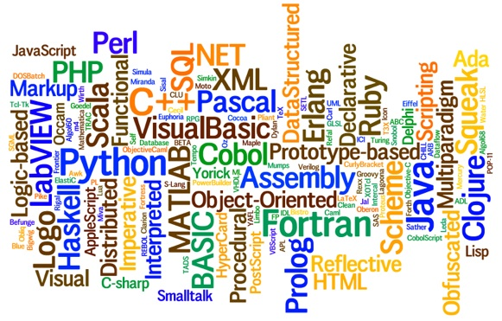
C++, Java, Visual Basic, and COBOL are examples of __________ __________.

Slide 5
C++, Java, Visual Basic, and COBOL are examples of __high-level programming languages________ __________.

Slide 6

A(n) __________ is used to convert assembly language instructions to machine language

Slide 7
A(n) _assembler_________ is used to convert assembly language instructions to machine language

Slide 8

A(n) __________ is used to convert high-level language instructions to machine language.

Slide 9
A(n) _compiler_________ is used to convert high-level language instructions to machine language.

Slide 10

The __________ structure is the most simple of the basic control structures.

Slide 11
The _sequence_________ structure is the most simple of the basic control structures.

Slide 12
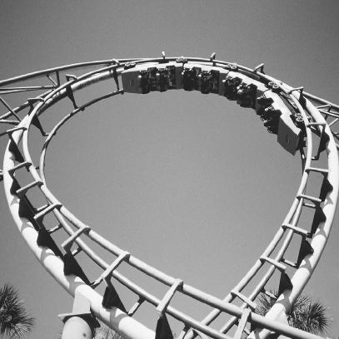
The __________ structure allows the programmer to create a loop in a program.

Slide 13
The repetition__________ structure allows the programmer to create a loop in a program.

Slide 14

The __________ structure allows the programmer to evaluate a condition in a program.

Slide 15
The decision__________ structure allows the programmer to evaluate a condition in a program.

Slide 16

The selection structure is commonly called the _--_____structure.

Slide 17
The selection structure is commonly called the _decision_________ structure.

Slide 18
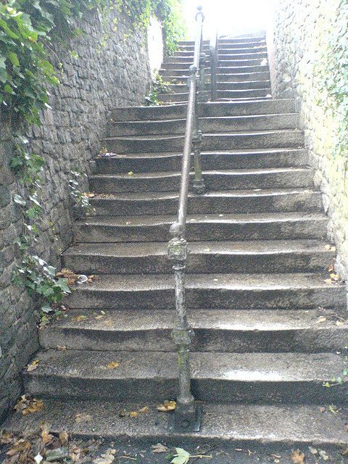
When you solve everyday problems, you go through a series of __________, usually without even thinking about them.

Slide 19
When you solve everyday problems, you go through a series of __steps________, usually without even thinking about them.

Slide 20

The first and most important step in the problem-solving process is to __________ __________ __________.

Slide 21
The first and most important step in the problem-solving process is to ___analyze the problem__________.

Slide 22
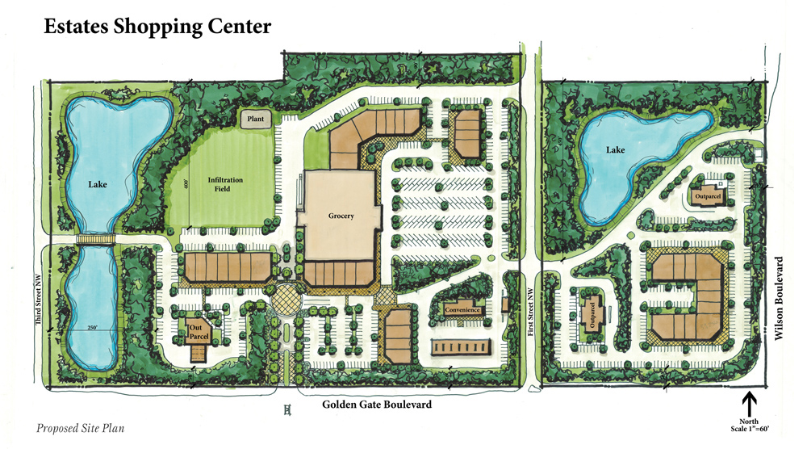
The second step in the problem-solving process is to __________ __________ __________.

Slide 23
The second step in the problem-solving process is to _plan_________ the__________ _algorithm_________.

Slide 24
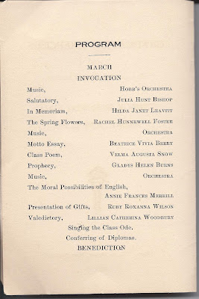
After desk-checking the algorithm, the algorithm can now be converted into an actual ___________.

Slide 25
After desk-checking the algorithm, the algorithm can now be converted into an actual code___________.

Slide 26

The last step in the problem-solving process is to __________ and __________ (if necessary) the program.

Slide 27
The last step in the problem-solving process is to evaluate______ and _modify___ (if necessary) the program.

Slide 28
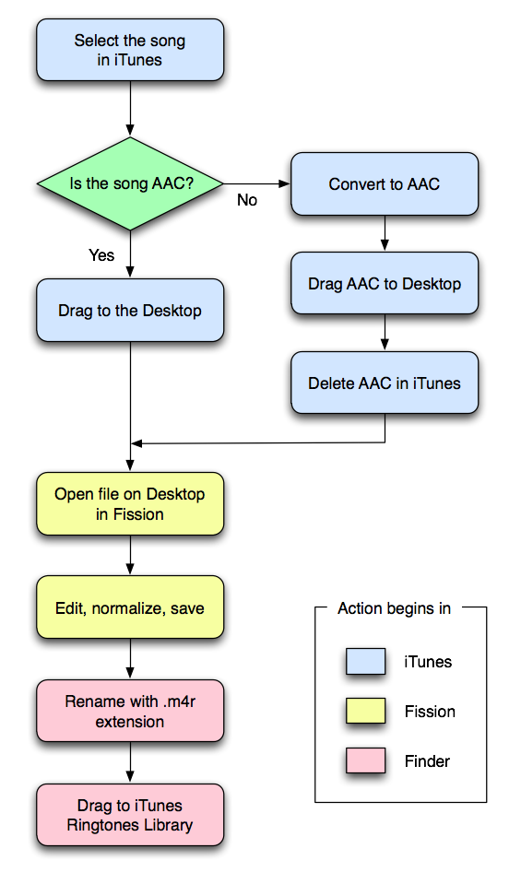
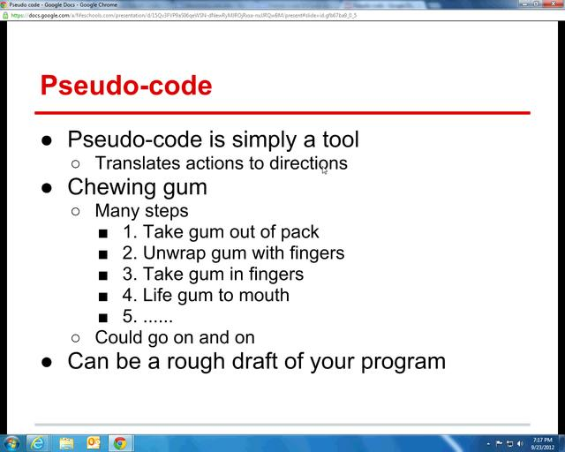
Two aids when designing a solution to a problem are __________ and __________.

Slide 29
Two aids when designing a solution to a problem are _flowcharts_________ and _pseudo-code_________.

Slide 30
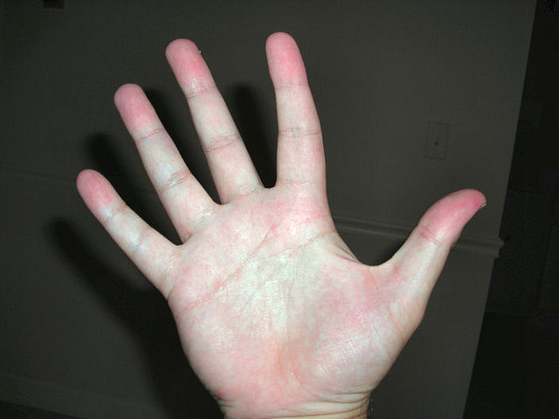
Another term for desk-checking is __________-tracing.

Slide 31
Another term for desk-checking is hand______-tracing.

Slide 32

A(n) __________ chart is used to organize and summarize the results of problem analysis.

Slide 33
A(n) _IPO_________ chart is used to organize and summarize the results of problem analysis.

Slide 34
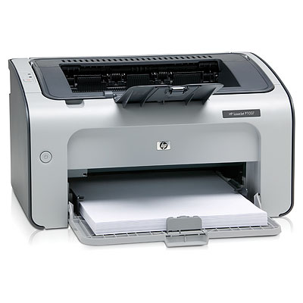


IPO stands for __________, __________, and __________.

Slide 35
IPO stands for __input___, _processing___, and _output___.

Slide 36
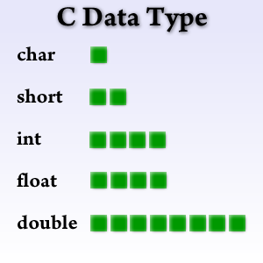
After naming the item in an IPO chart, a(n) __________ __________ must be chosen.

Slide 37
After naming the item in an IPO chart, a(n) _datatype_________ __________ must be chosen.

Slide 38


In C++, the two types of memory locations available for you to temporarily store data are __________ and __________ __________.

Slide 39
In C++, the two types of memory locations available for you to temporarily store data are variables and named constants_ __________.

Slide 40
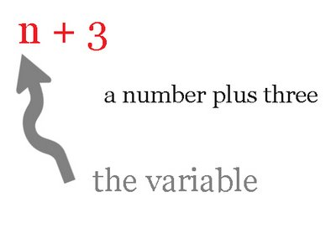
The value of a(n) __________ is permitted to change during the execution of a program.

Slide 41
The value of a(n) variable is permitted to change during the execution of a program.

Slide 42

A(n) __________ is also known as a reserved word.

Slide 43
A(n) keyword is also known as a reserved word.

Slide 44
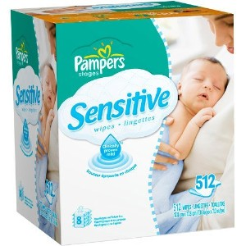
The last rule in naming identifiers in C++ is that all identifiers are case __________.

Slide 45
The last rule in naming identifiers in C++ is that all identifiers are case sensitive_.

Slide 46

The string data type is not one of the __________ data types in C++.

Slide 47
The string data type is not one of the built-in data types in C++.

Slide 48

Numbers are represented in internal memory using the __________ number system.

Slide 49
Numbers are represented in internal memory using the binary number system.

Slide 50

Variables of type __________ can take on the values of true and false.

Slide 51
Variables of type boolean can take on the values of true and false.

Slide 52

The float and double data types store __________ numbers.

Slide 53
The float and double data types store _real_ numbers.

Slide 54

Unlike variables and named constants, __________ constants are not memory locations.

Slide 55
Unlike variables and named constants, _literal constants are not memory locations.

Slide 56

A string literal constant is zero or more characters enclosed in __________ quotation marks.

Slide 57
A string literal constant is zero or more characters enclosed in _double_ quotation marks.

Slide 58

A character literal constant is a single character enclosed in __________ quotation marks.

Slide 59
A character literal constant is a single character enclosed in _single_ quotation marks.

Slide 60

The __________ keyword is used to indicate that a memory location is a named constant.

Slide 61
The _constant_ keyword is used to indicate that a memory location is a named constant.

Slide 62
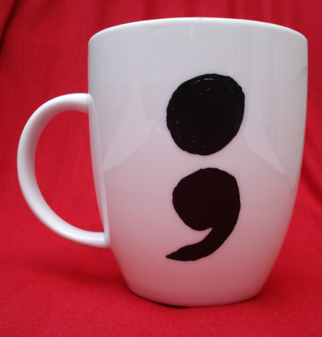
All statements in C++ must end with a(n) __________.

Slide 63
All statements in C++ must end with a(n) semicolon_.

